Slide 1
“Bewitch the mind, ensnare the senses”
Defense against the Dark Arts

Slide 2
Before we start:
CompClub has been extremely fortunate to have this day approved to run. We believe that educating students about security techniques is a huge priority in a world where technology is growing rapidly. We’d love to run this program again next year but can only do so if we can maintain a good standing with official authorities and sponsors. Do not do anything that would put yourself or this course at risk of disrepute.
Please keep in mind that it is illegal to attempt to access or interfere with computer systems & physical locks (that you don’t own). Do not attempt to hack any website. Enter CTFs (Capture the Flags) and bug bounties to learn more and practice your skills.

Slide 3
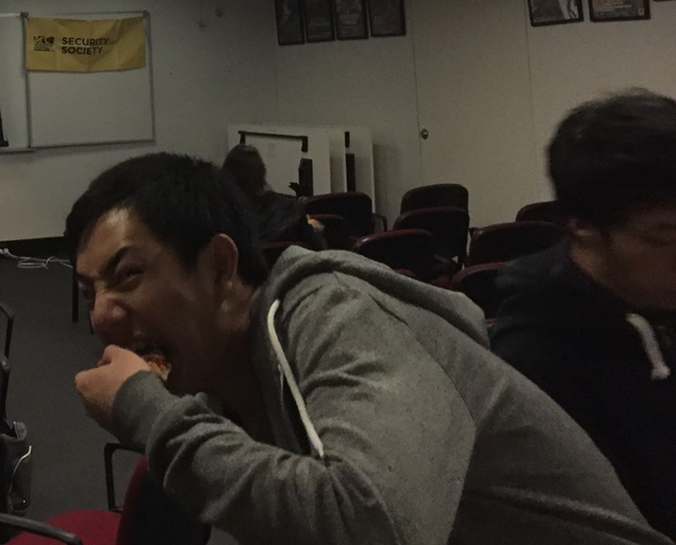
>_ Welcome to SecDay
Who dis?
•Hi I’m Bryan
•I started learning security a year and a half ago
•I teach security, go to security conferences, do security things
•I’ll be teaching you offensive and defensive security techniques to help ensure your own safety and identify where you might be vulnerable.

Slide 4
Three Main Branches
Physical Security
Protecting stuff you can touch with stuff you can touch.
Architectural Security
Locks/Lockpicking
Martial Arts
X-Ray Scanners
Weapon use
Fire extinguishers
SmokeCloak TM
Parkour?
Cyber Security
Protecting things controlled by computers, with computers.
XSS
Cookie Stealing
SQL Injection
(D)DOS Attacks
Cross Site Request Forgery
Encryption
Password Security
Network Security
Social Security
Protecting people from leaking information.
Phishing
Social Engineering
Grifters
Phone Phreaks
Identity theft
Privacy Settings
Authorisation Protocols
“Con-Men”

Slide 5
Three Main Branches
Physical Security
Protecting stuff you can touch with stuff you can touch.
Architectural Security
Locks/Lockpicking
Martial Arts
X-Ray Scanners
Weapon use
Fire extinguishers
SmokeCloak TM
Parkour?
Cyber Security
Protecting things controlled by computers, with computers.
XSS
Cookie Stealing
SQL Injection
(D)DOS Attacks
Cross Site Request Forgery
Encryption
Password Security
Network Security
Social Security
Protecting people from leaking information.
???

Slide 6
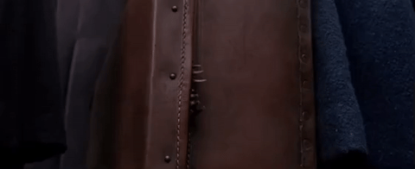
Fantastic FLAG{4nd_wh3re_2_f1nd_th4m}
FLAG{look_closer}

Slide 7
Locks?

Slide 8
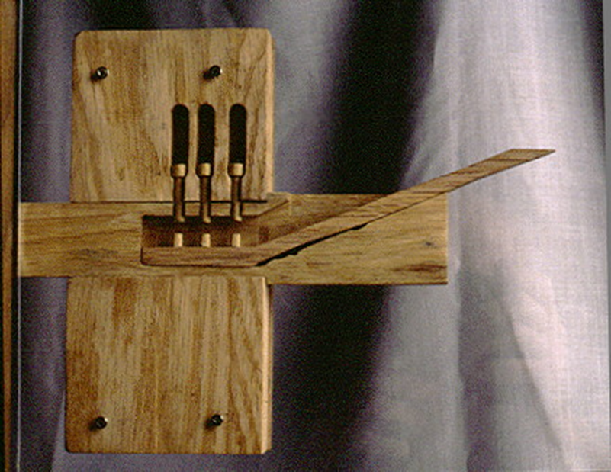
Early Locks
One of the earliest lock designs originates from Egypt (20th Century BC)
Made entirely from wood
Probably flammable
Rain would be a pain
Low Durability

Slide 9
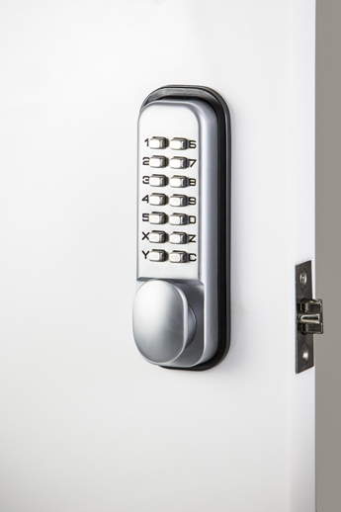
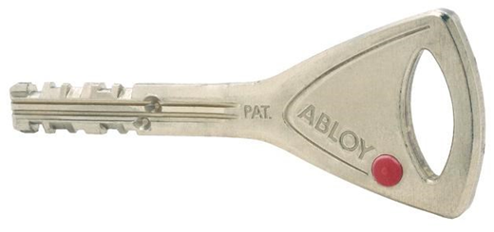
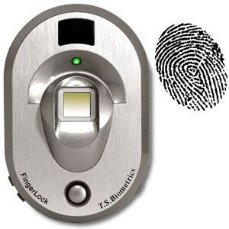
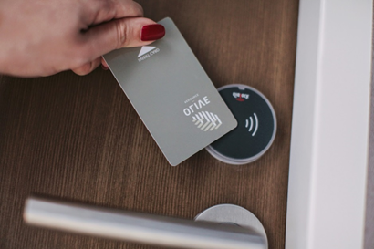
Modern (Fancy) Locks
Biometric Security
Key Cards
Combination Locks
Abbloy Protec 2

Slide 10
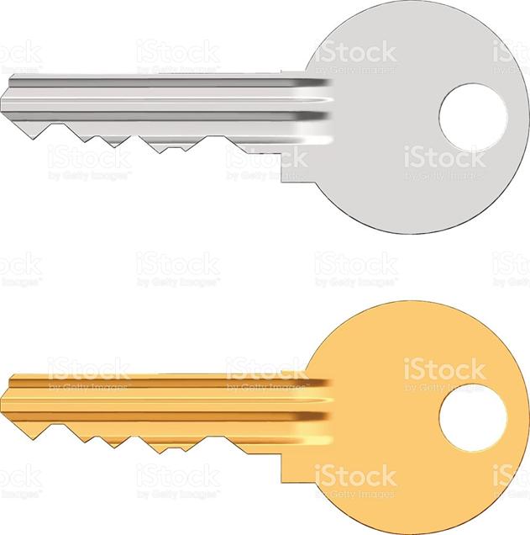
Does your key look like this?

Slide 11
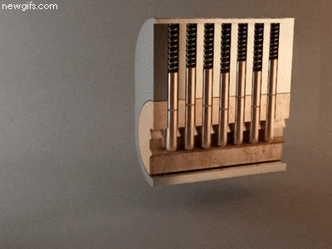
The humble pin tumble

Slide 12
Lockpicking

Slide 13


Navigating lock imperfections
Impossible to pick
More doable
Notes:
Live demo here

Slide 14
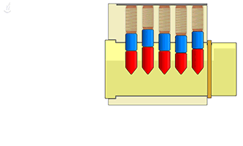
Notes:
Replace this sl

Slide 15
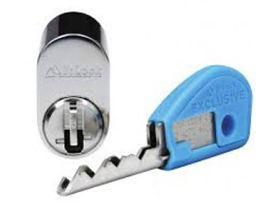
More pins
Australian Designed Bi-Lock
More Pins = More Effort
Completely different internal mechanisms
Impossible to bump
Claims to be unpickable but there’s videos on the internet...
Notes:
http://www.lockpickingforensics.com/articles/bilock.pdf

Slide 16
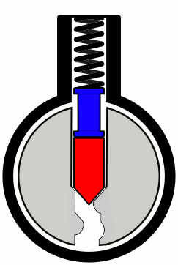
Spool Pins
Exploits bugs in the picking method
Prematurely twisting the barrel locks pins in place
Can be rectified by easing up torsion on the barrel but doing so risks resetting all picked pins

Slide 17
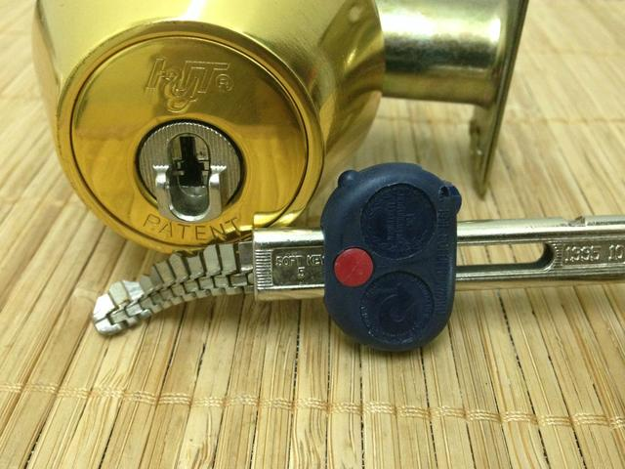
Novel Keys
Hyt Chain Key
Key Passageway is a snakey boi
Traditional picking tools are not snakey bois
Good luck copying this key...

Slide 18
Now it’s your turn!

